Slide 1
OCR-Based Autograder for Handwritten Content
Nina Nguyen

Slide 2
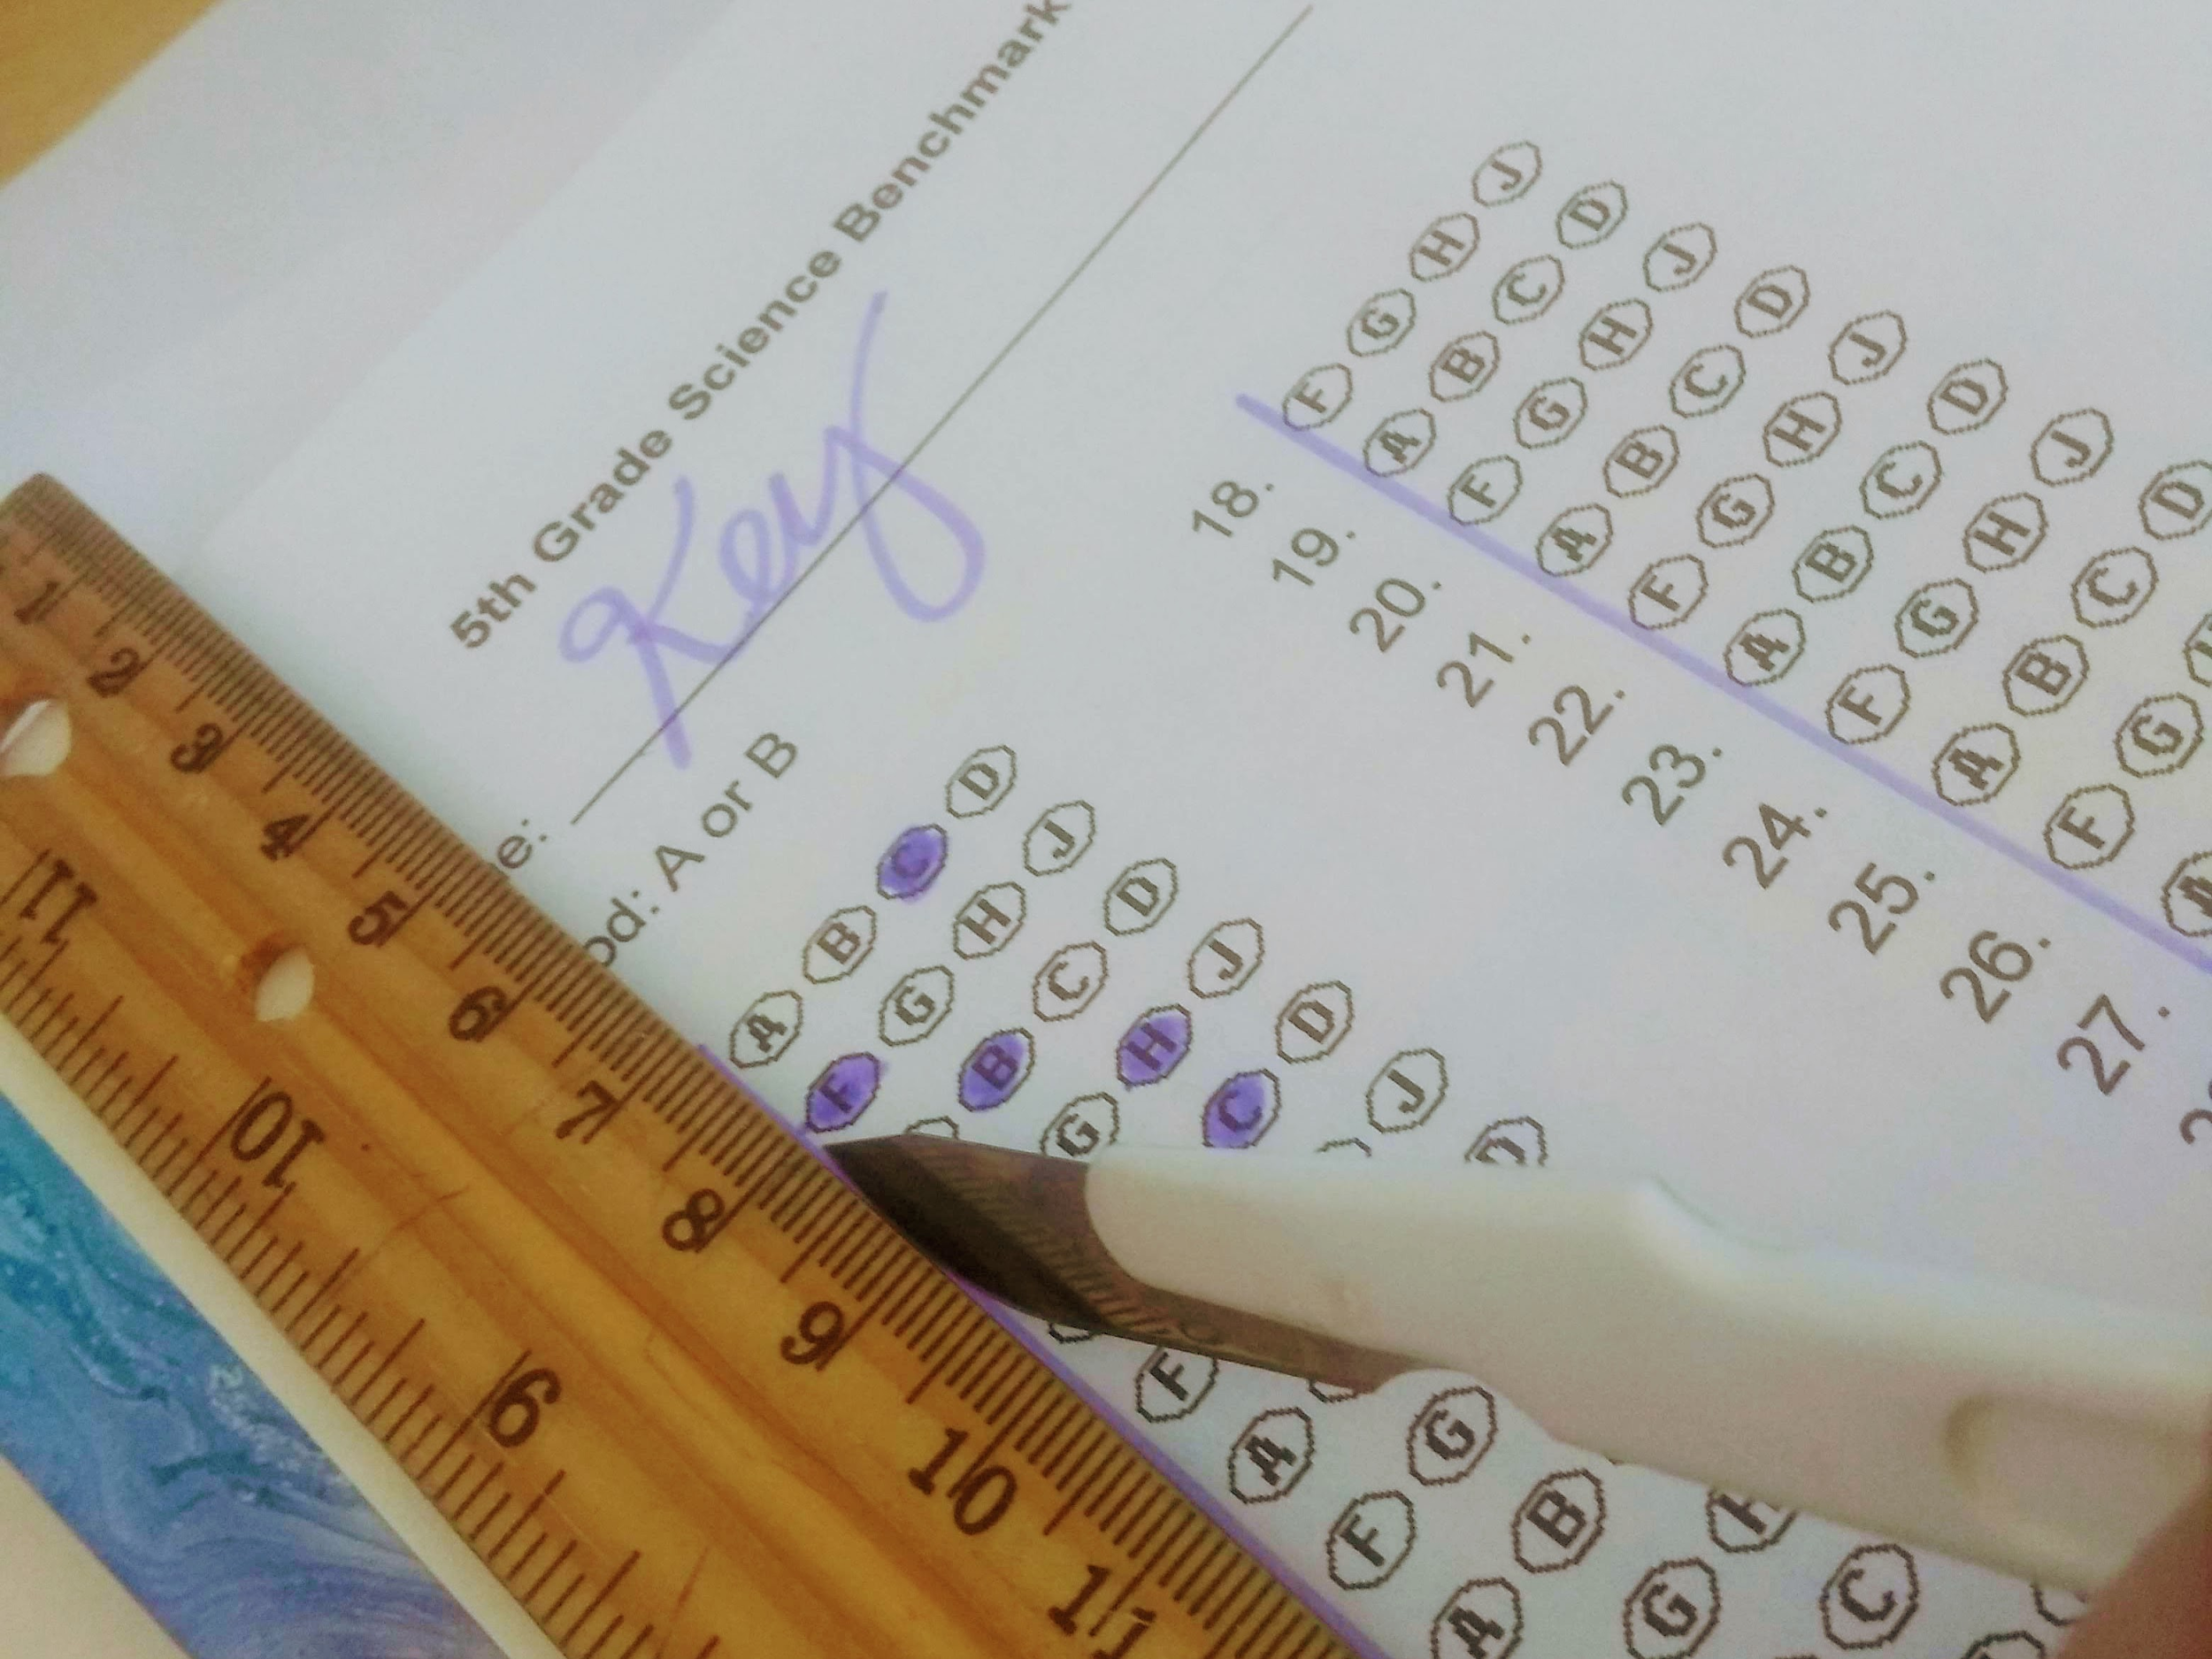
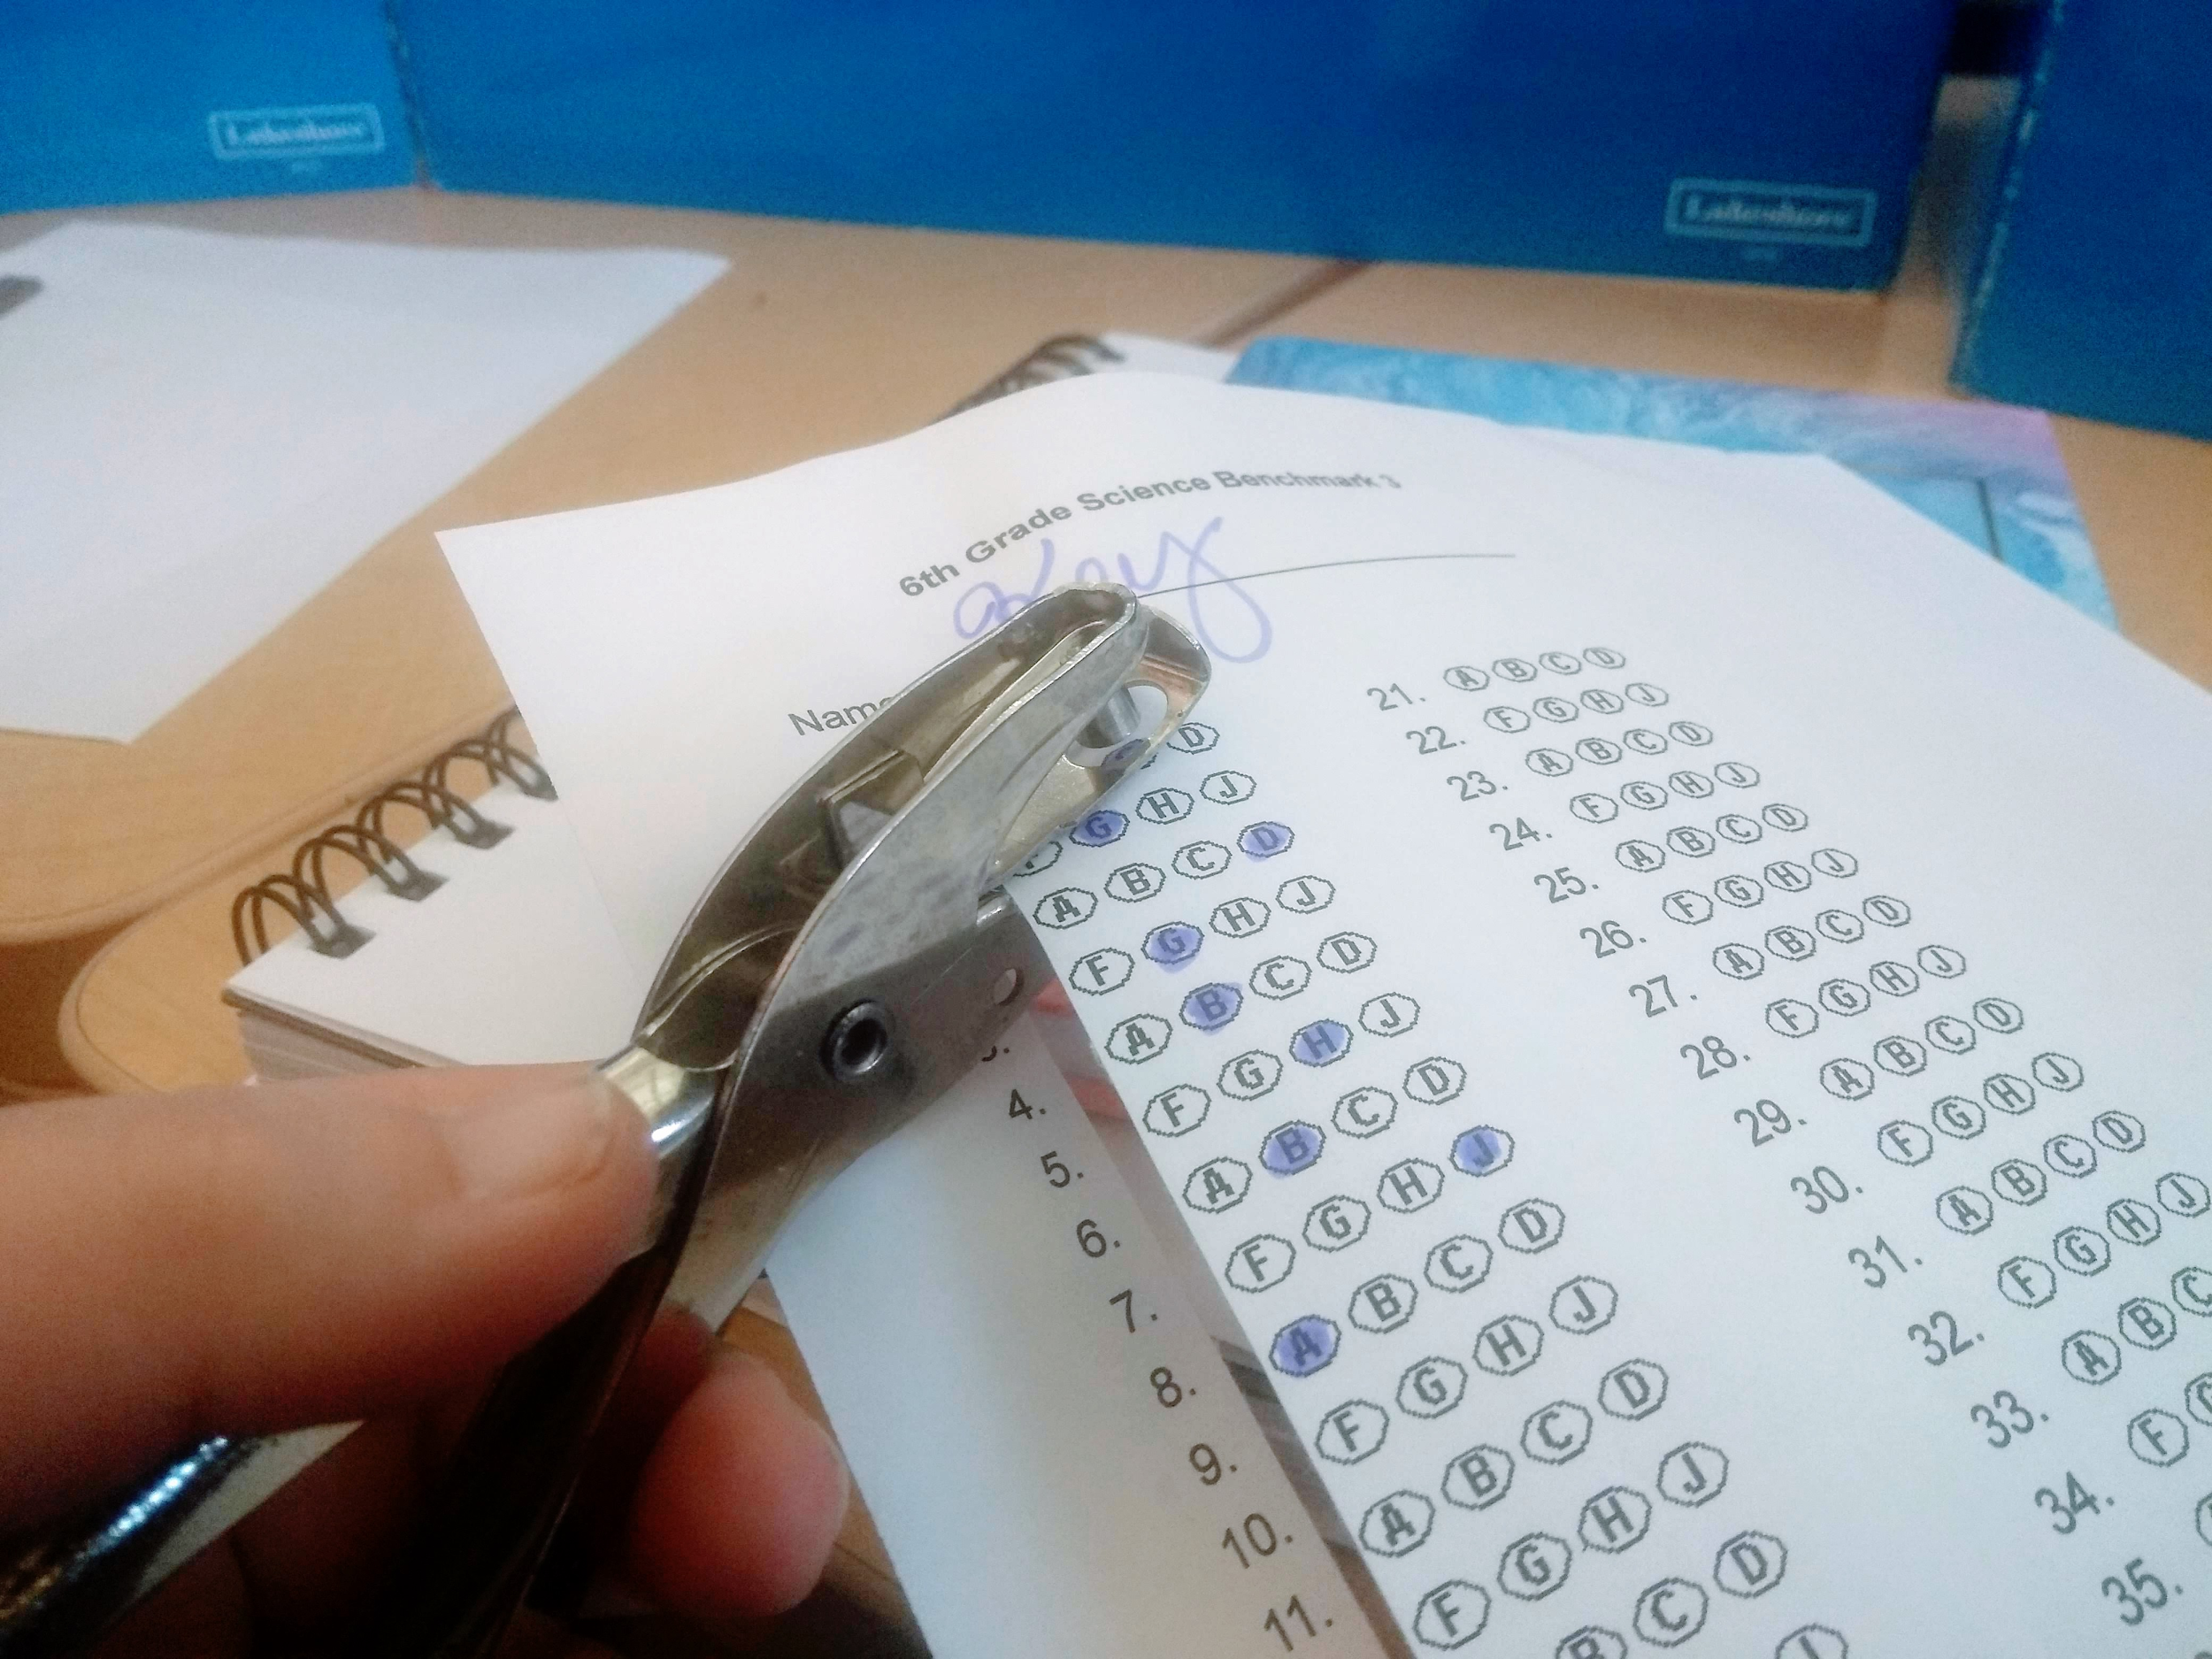
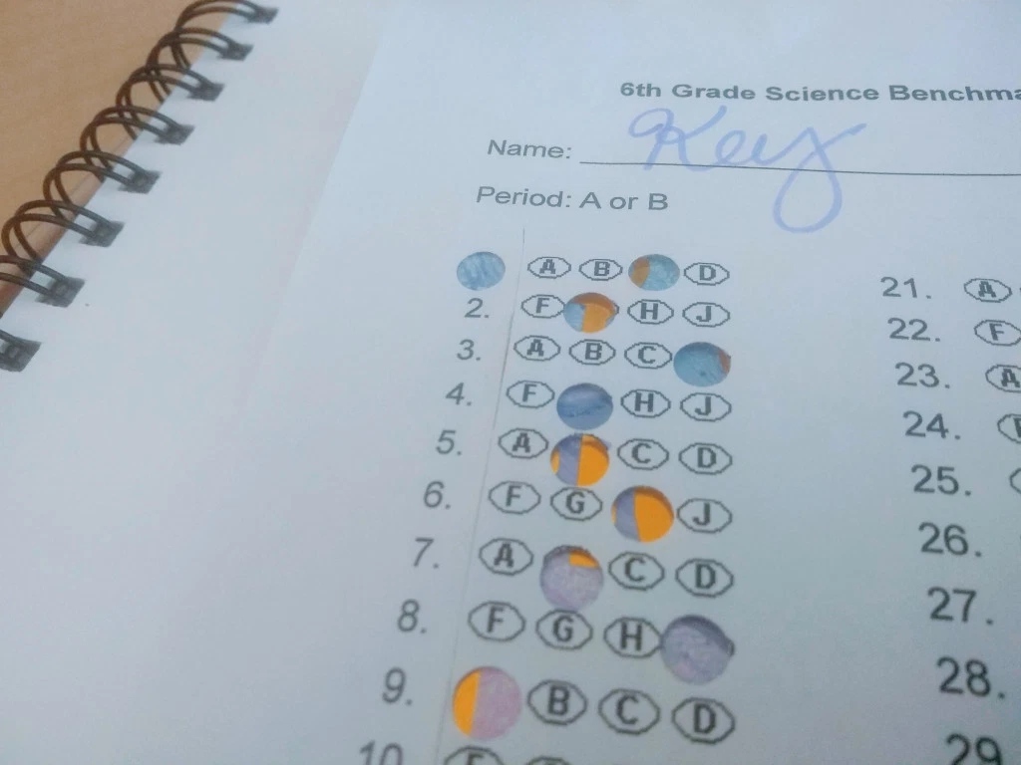
The Problem: Grading Sucks.
Good thing teachers are geniuses!
1) Cut up your answer key 2) Hole punch each correct answer 3) Overlay and hand-grade each test!
This was posted in February 2019…..

Slide 3
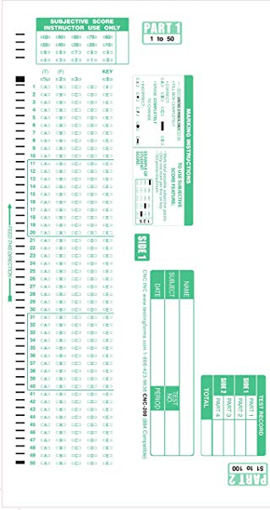
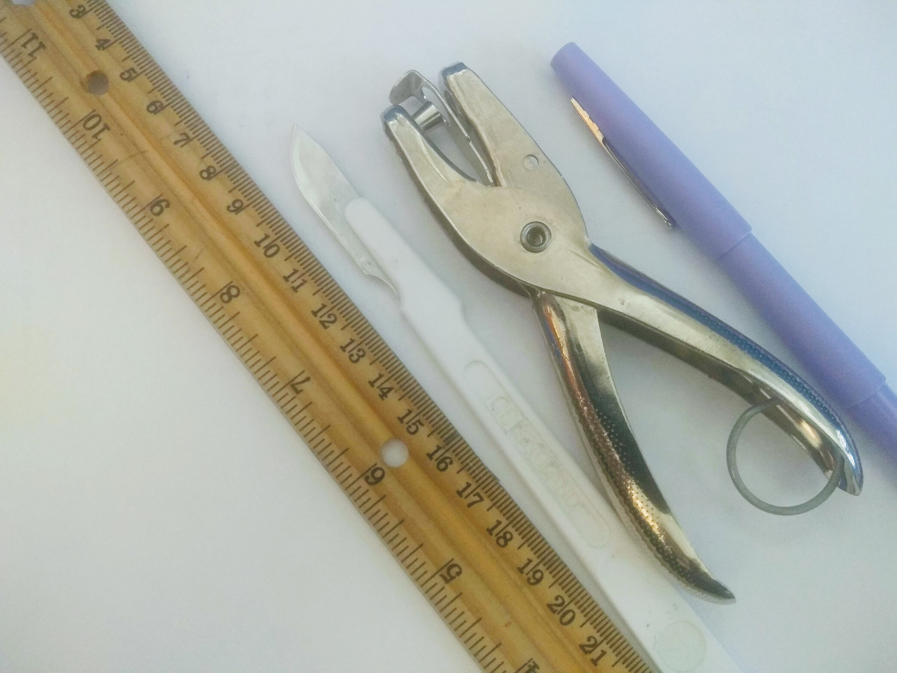
The Problem: Grading Sucks.
Technology is meant to be used.
….Seriously?
ScanTron took
a step in the
right direction.

Slide 4

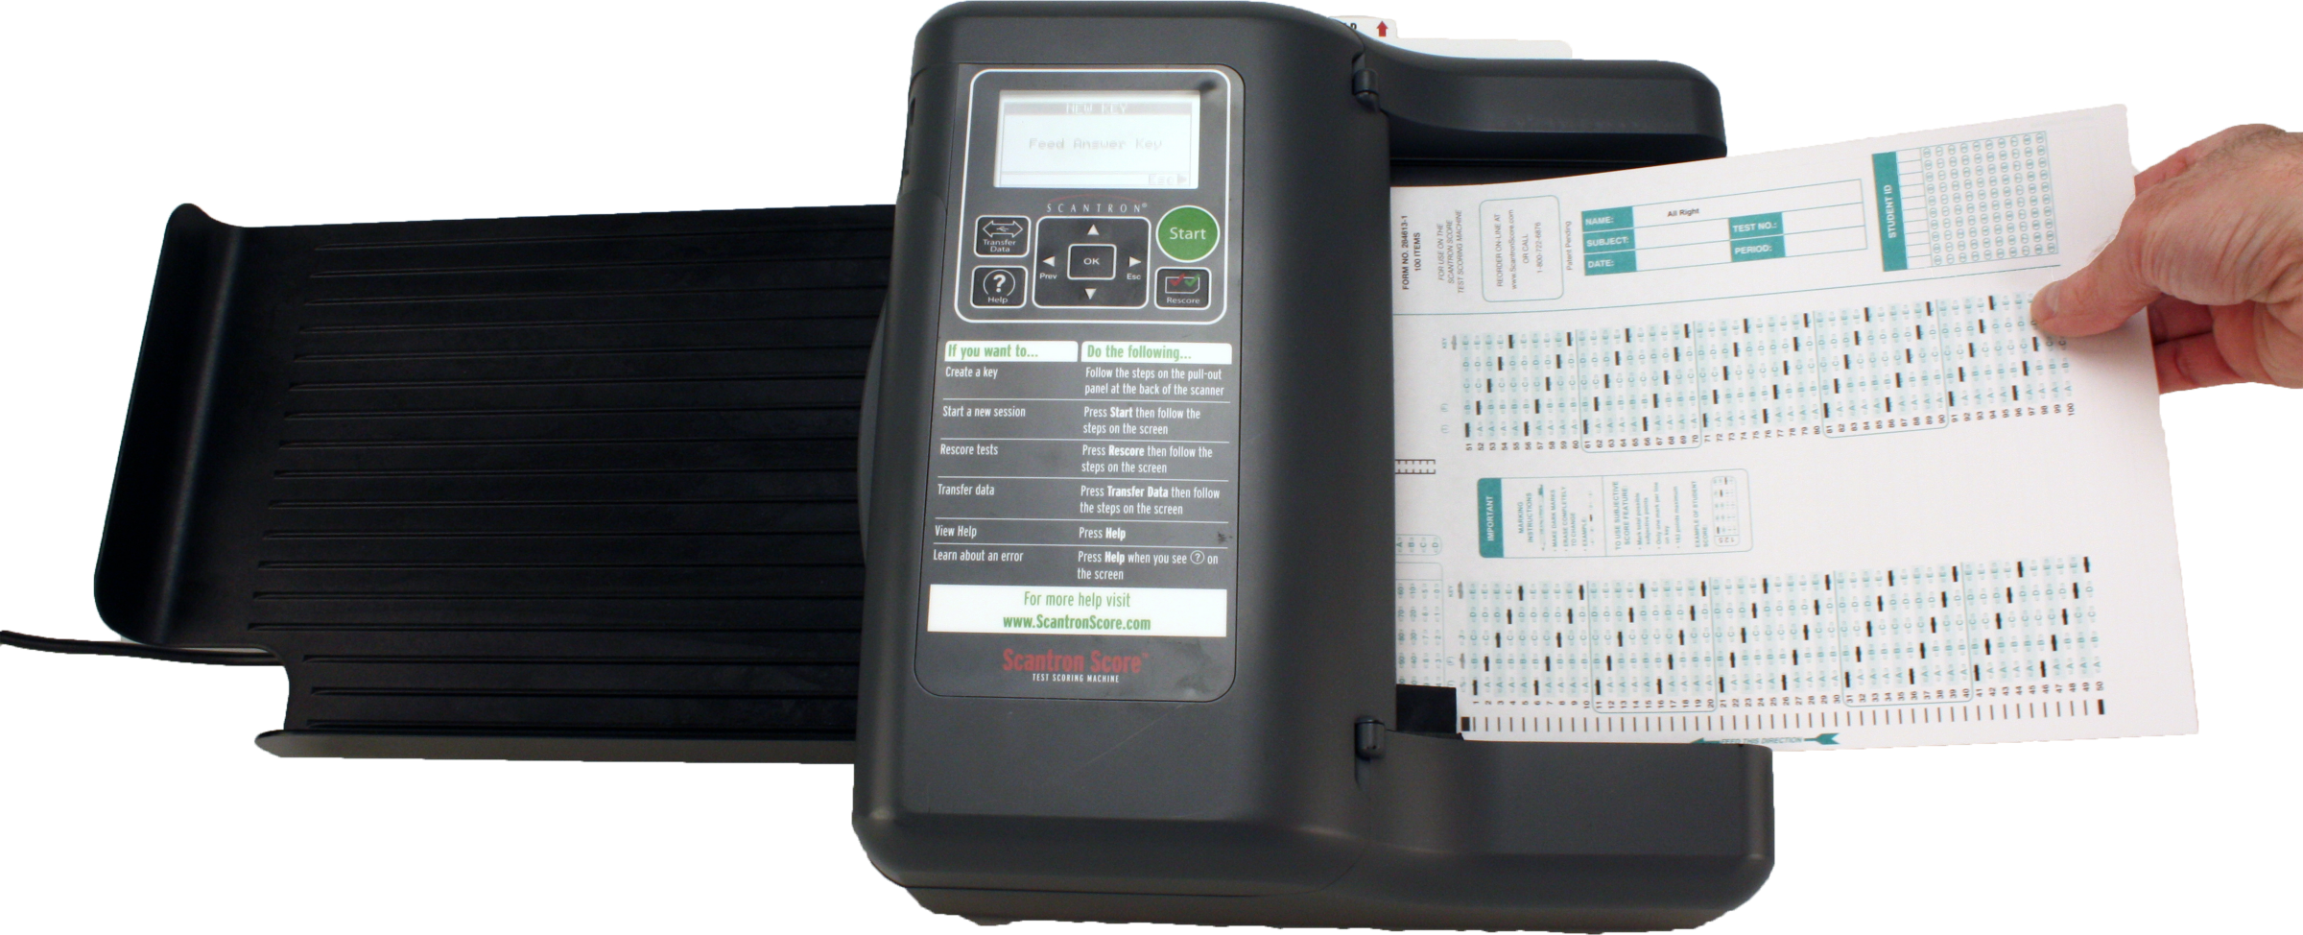
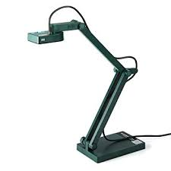
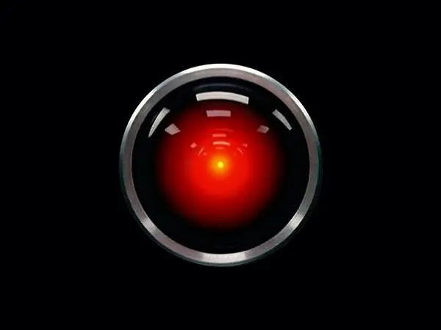


Inspiration
Illuminate has rendered ScanTron obsolete with OCR grading.
Key Features:
Test-specific forms
Automatic gradebook entry
Doc cam or webcam

Slide 5
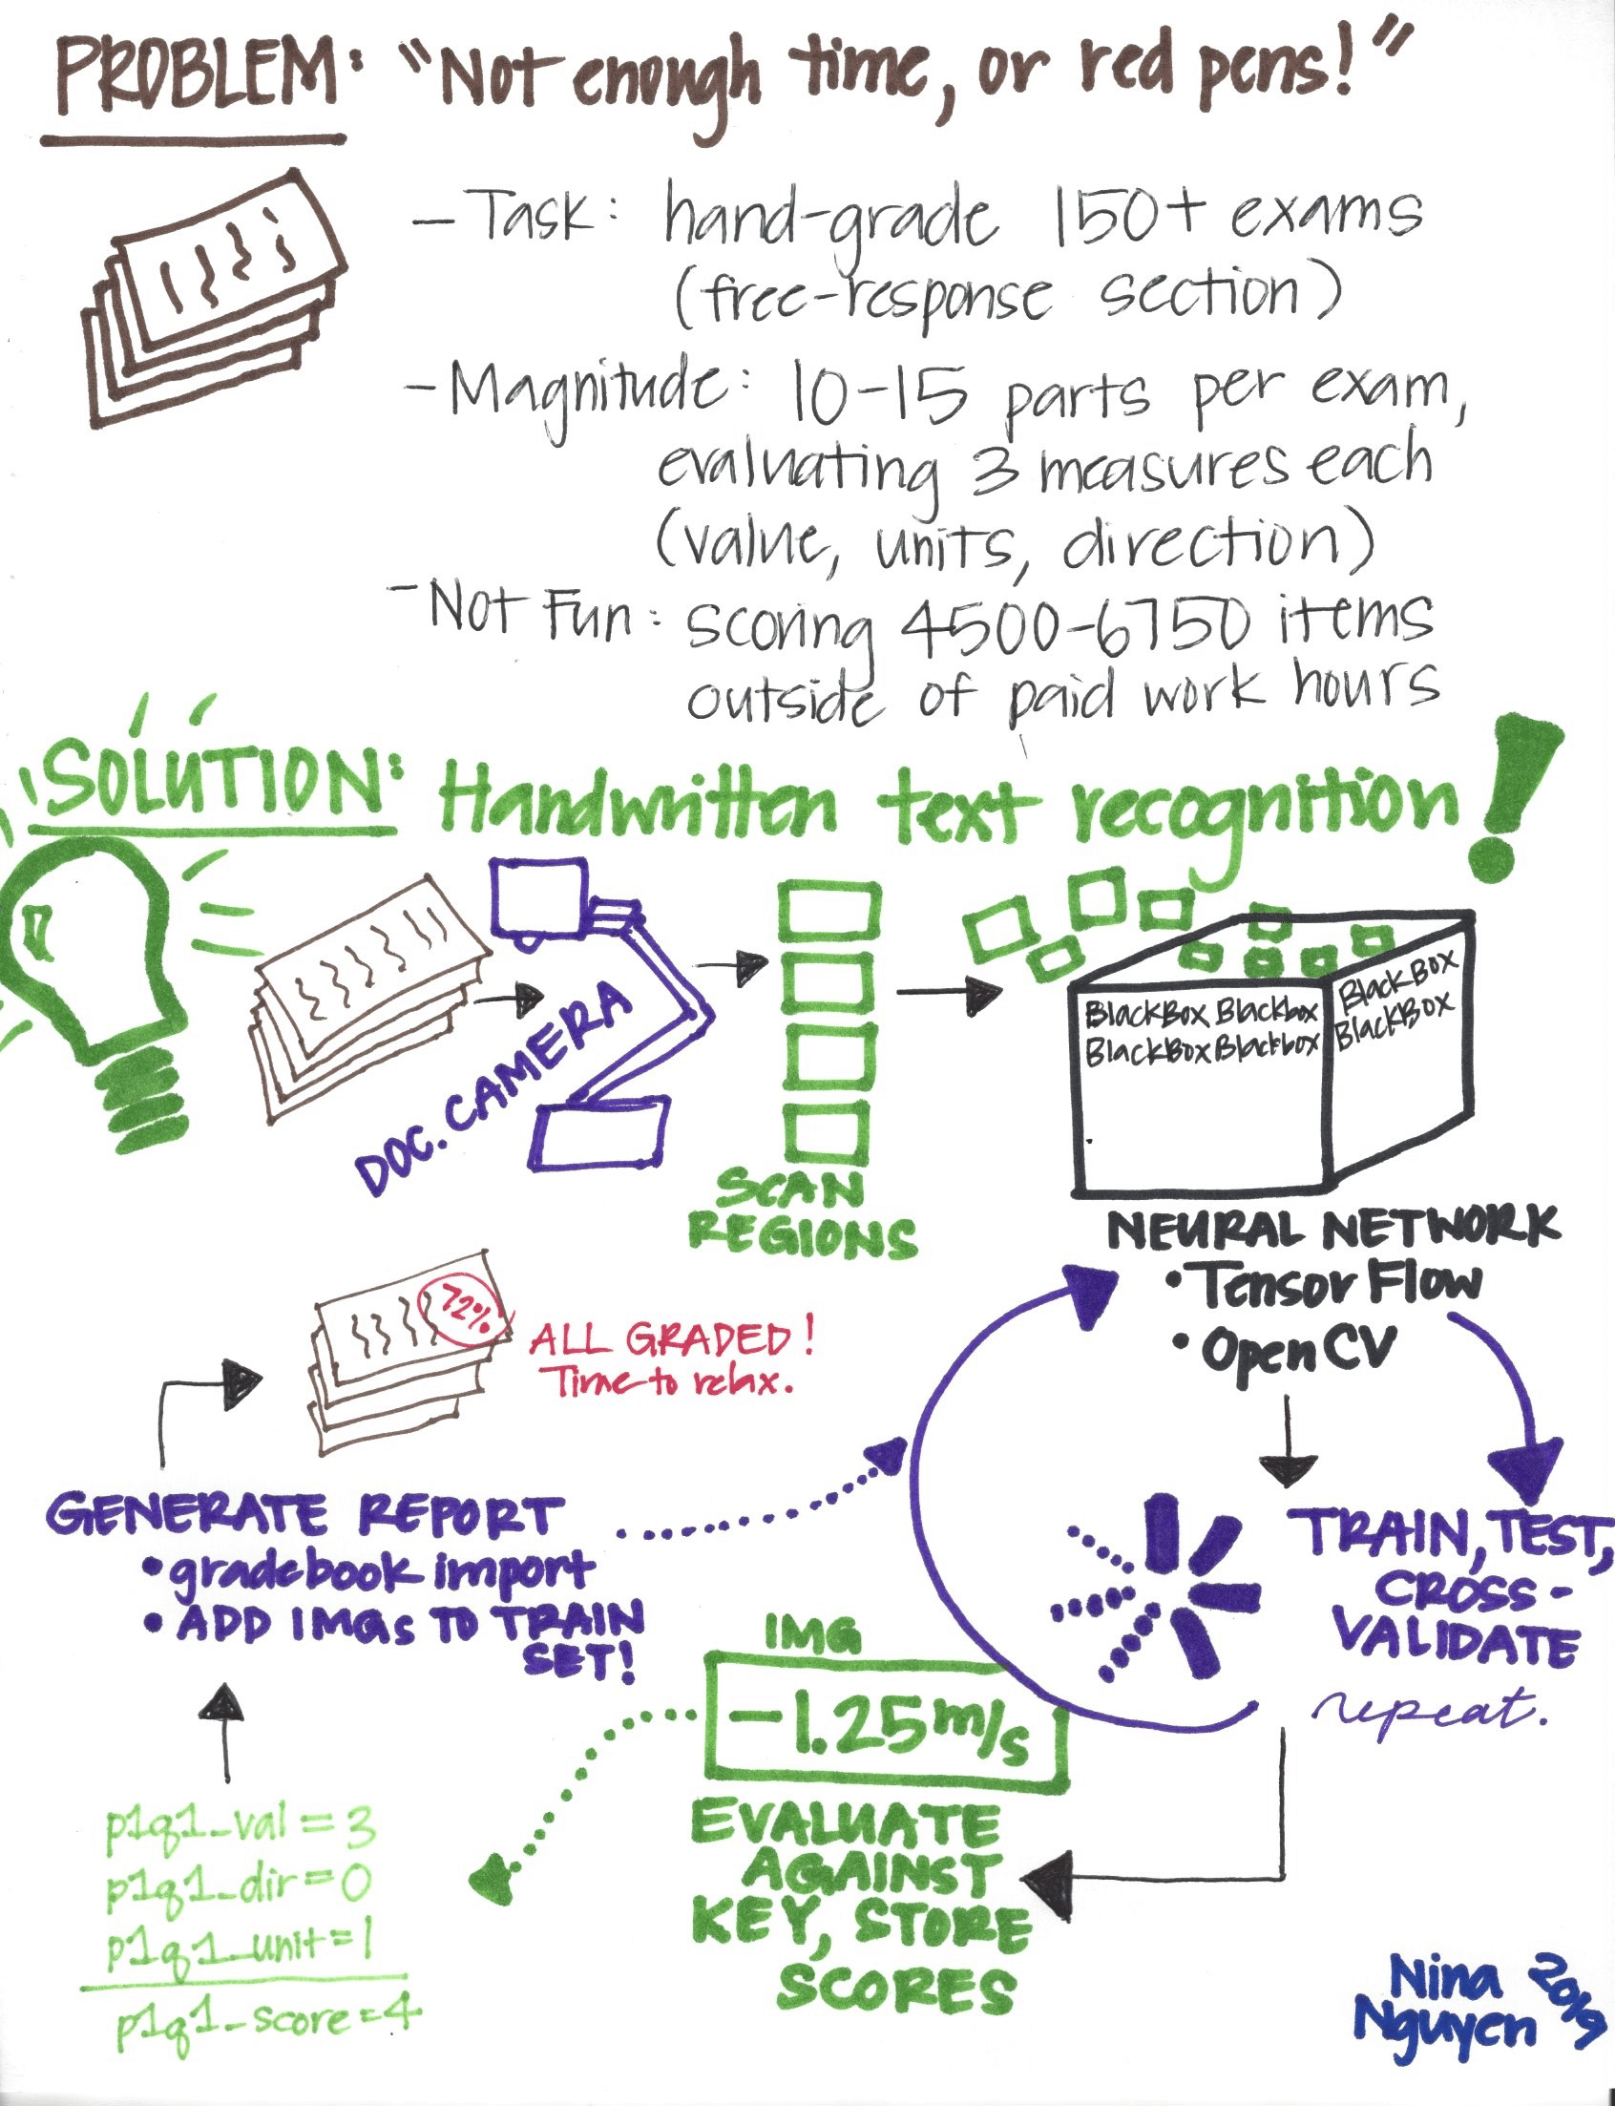
Free Response
Hand grading free-response questions for physics and math is a pain.
It is a monotonous process that can be automated due to limited characters and symbols, unlike English/history.
In other words: “Why do I even need you here? I can just write a bot.”
Why should a human do this when a computer can?

Slide 6
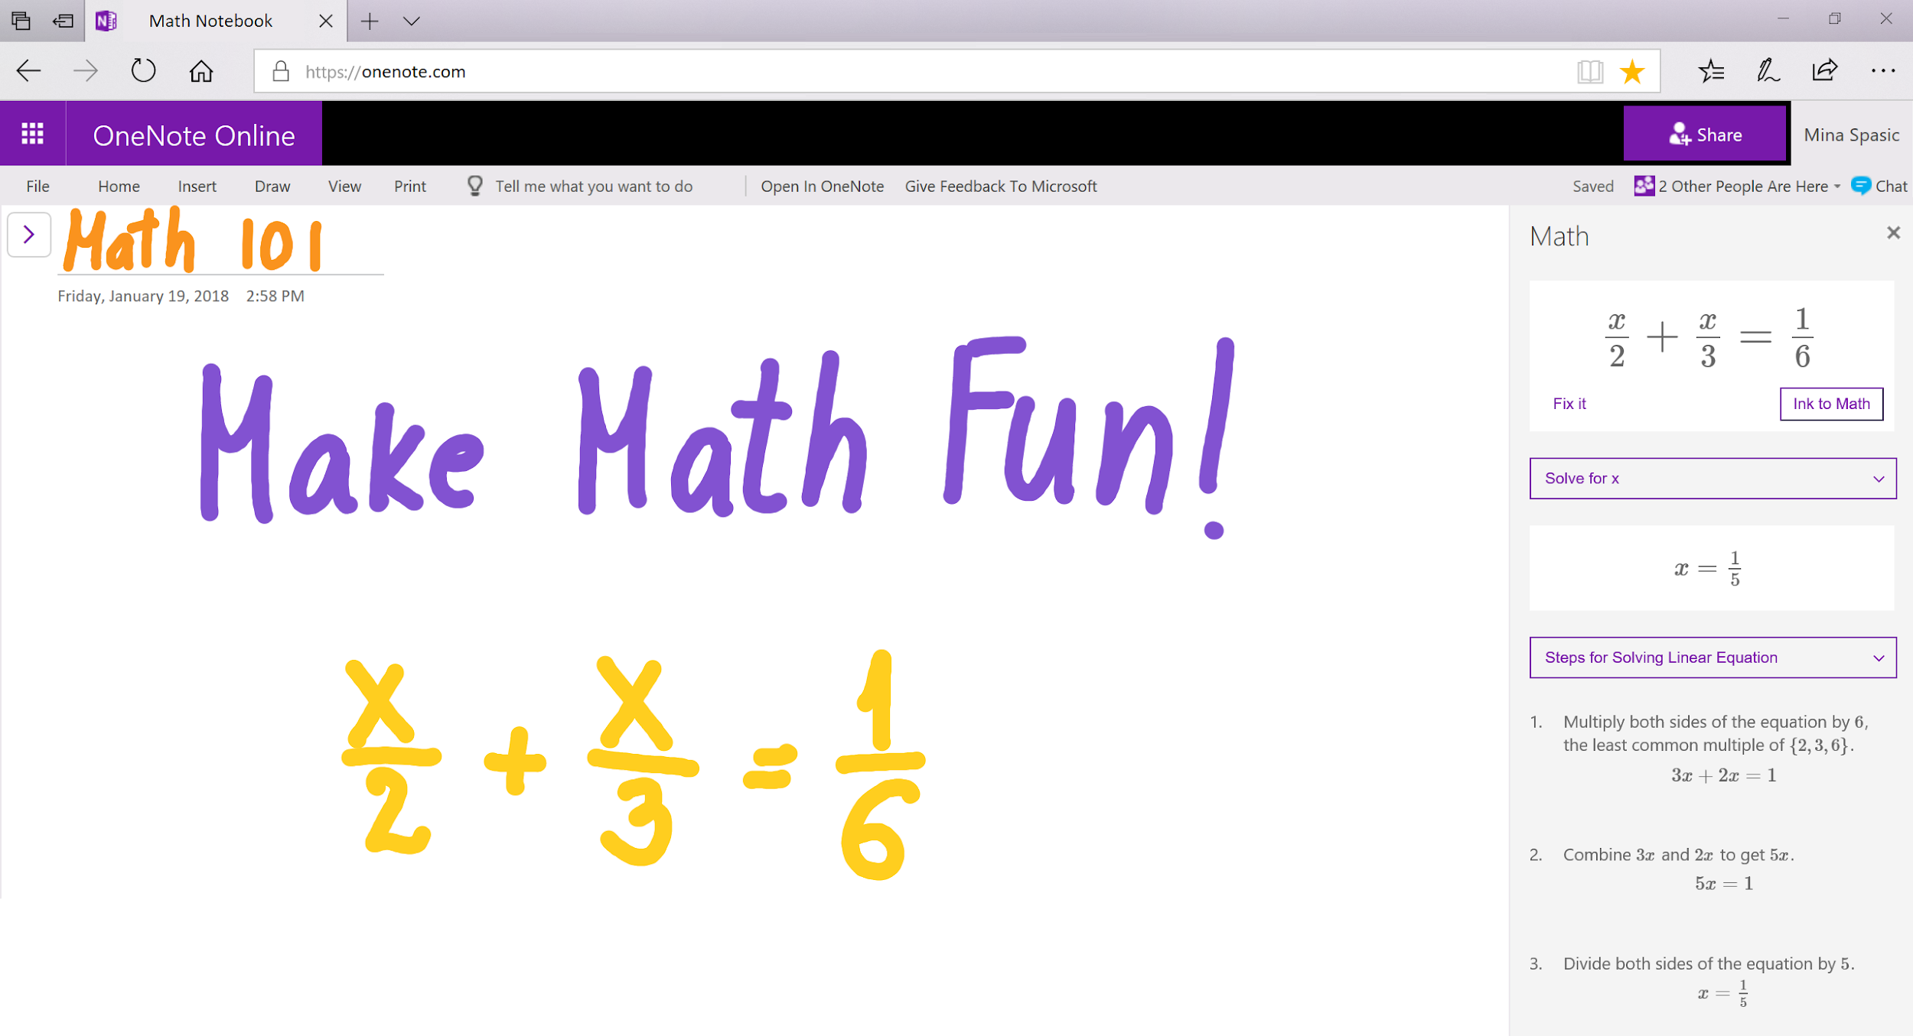

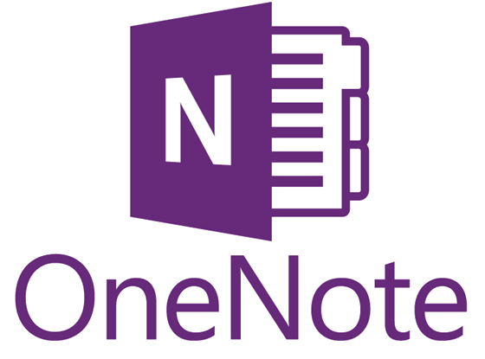
Ink-spiration
Penstroke recognition by Microsoft

Slide 7
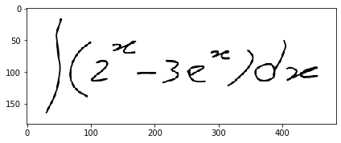
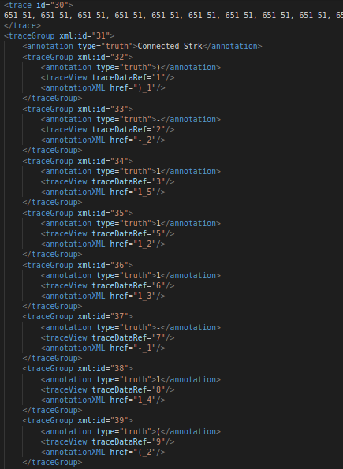
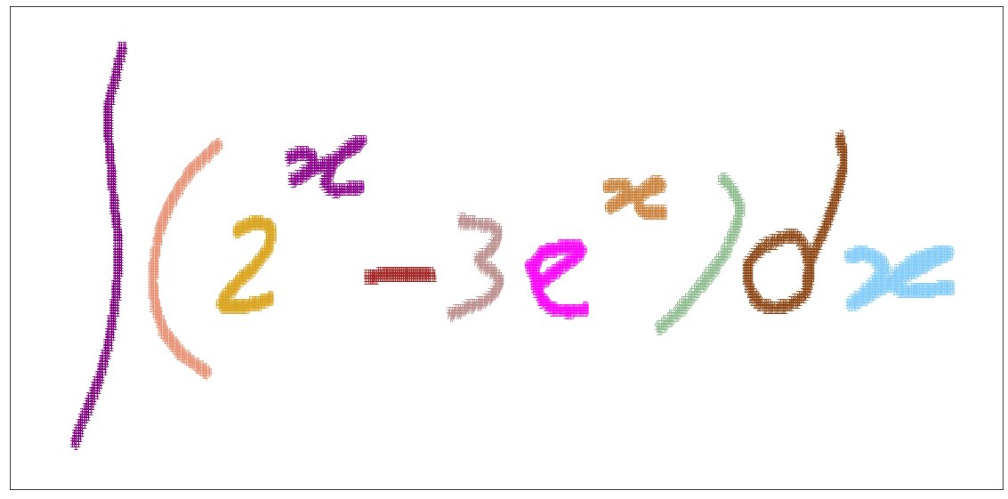
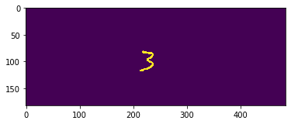
General Process
Raw Image
Segmentation
Object isolation/processing
0) Convert InkML to .png
InkML is a XML data type for digital ink data obtained from an electronic pen or stylus.

Slide 8
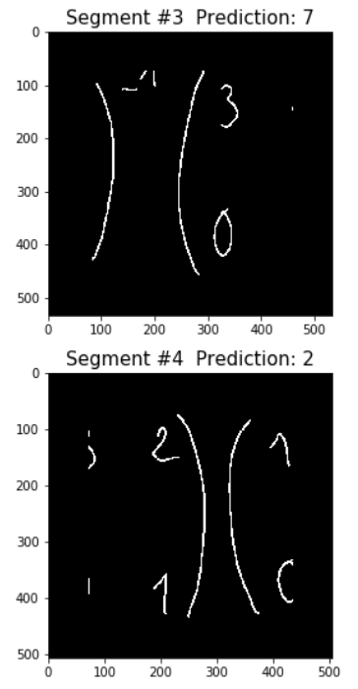
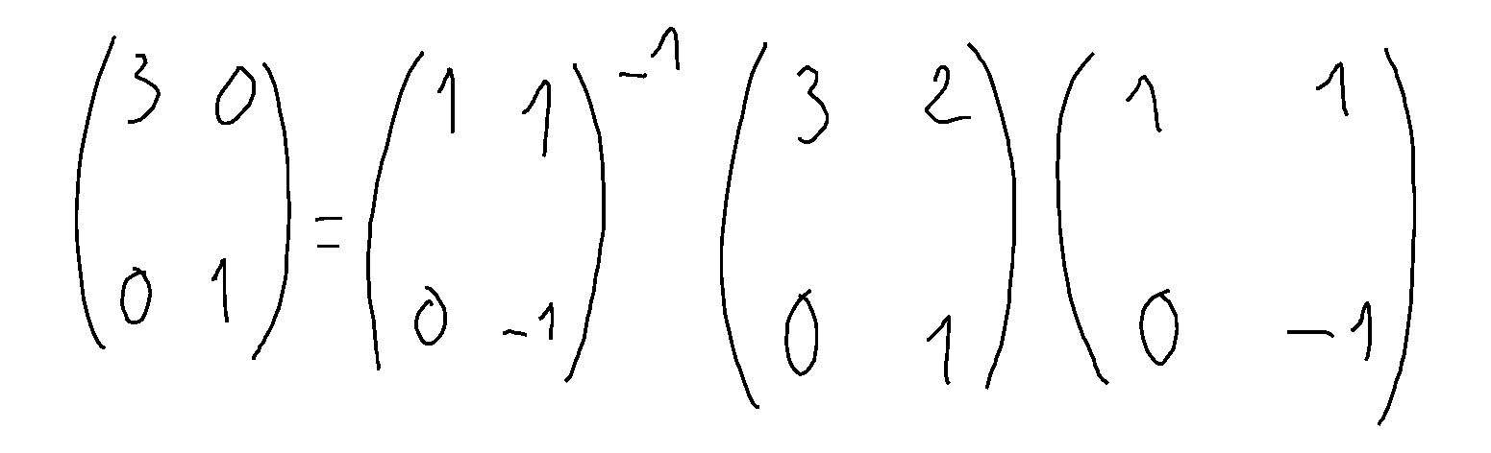
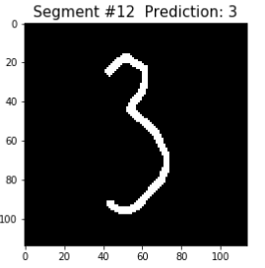
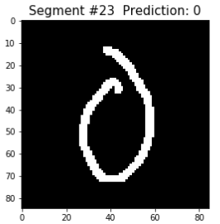
Segmentation Challenges
…...But wait, there’s more!
How many segments do you see?
As expected, we get:
and so on...

Slide 9
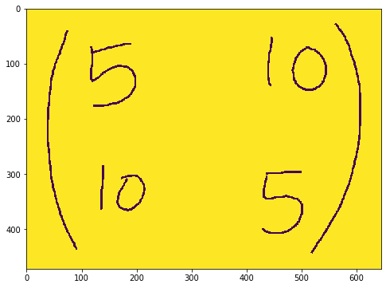
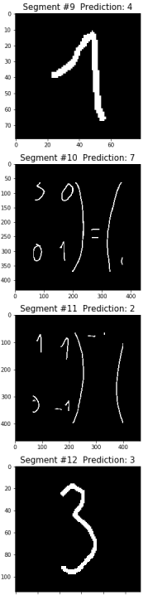
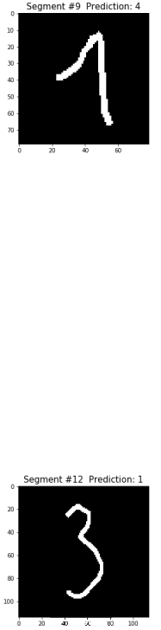
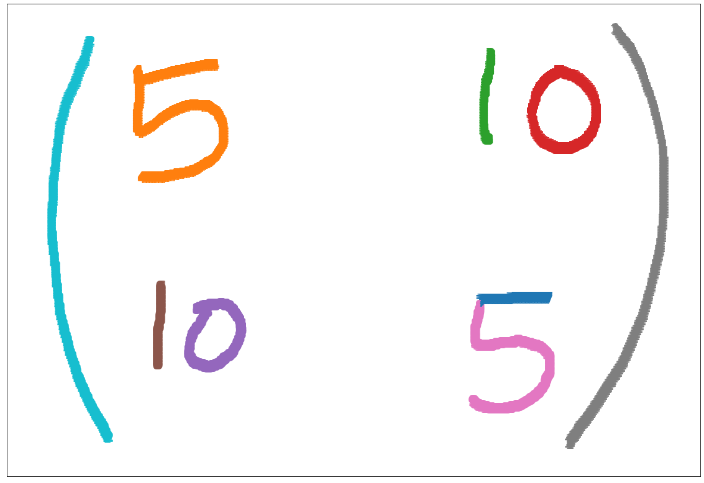
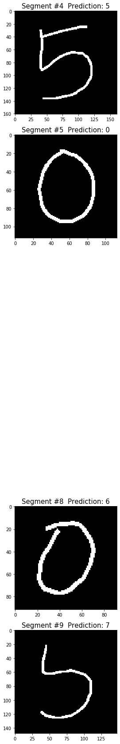
Segmentation Challenges
Write code to ignore such segments before isolation.
...which helps most things,
but can cause other issues.

Slide 10
Simplify the Problem at Hand: Generate Test Images

Slide 11
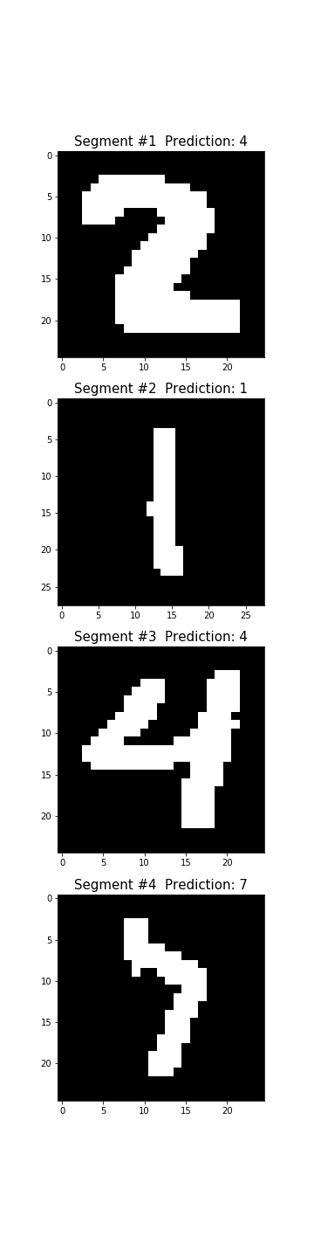
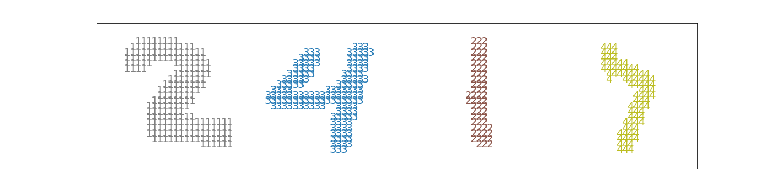
Process
Raw Image Creation
Segmentation
The Fun Part
Isolate objects
Make square (non-trivial task)
Resize to 28x28
Make individual predictions

Slide 12
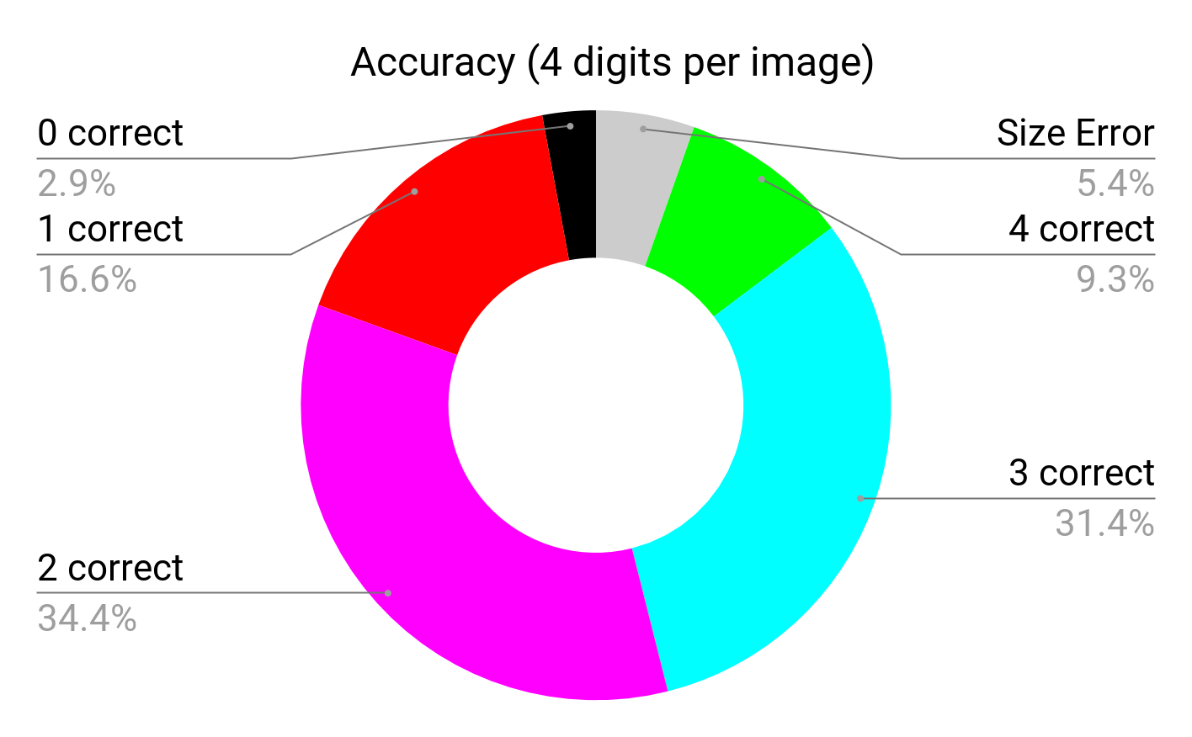
Decision Tree Classifier
2,500 images Accuracy (on 2,365) Mean: 0.558 SD: 0.245

Slide 13
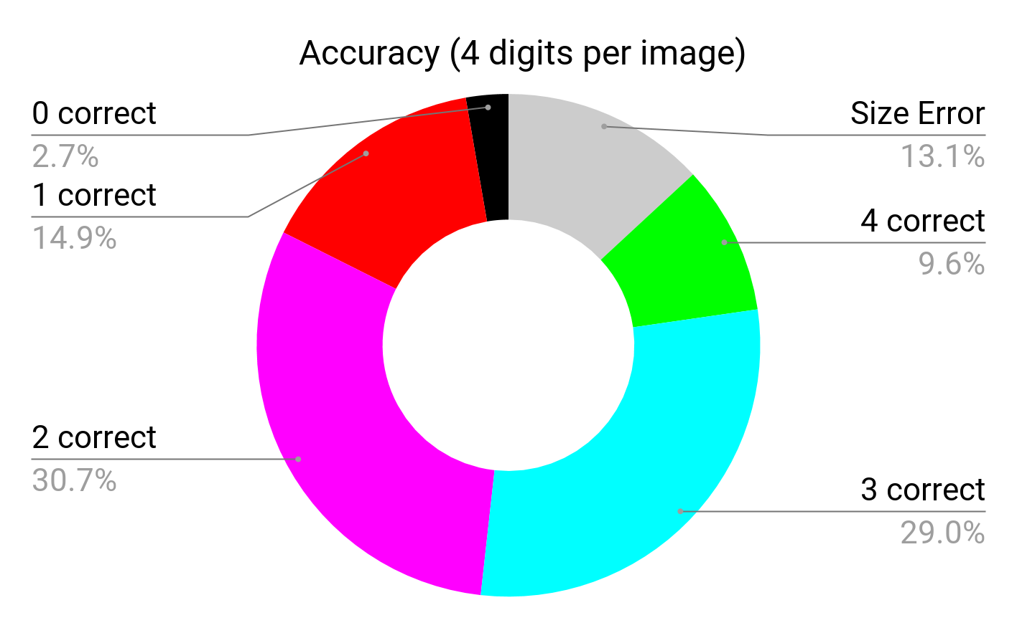
Decision Tree Classifier (again)
17,500 images Accuracy (on 15,208) Mean: 0.580 SD: 0.246

Slide 14
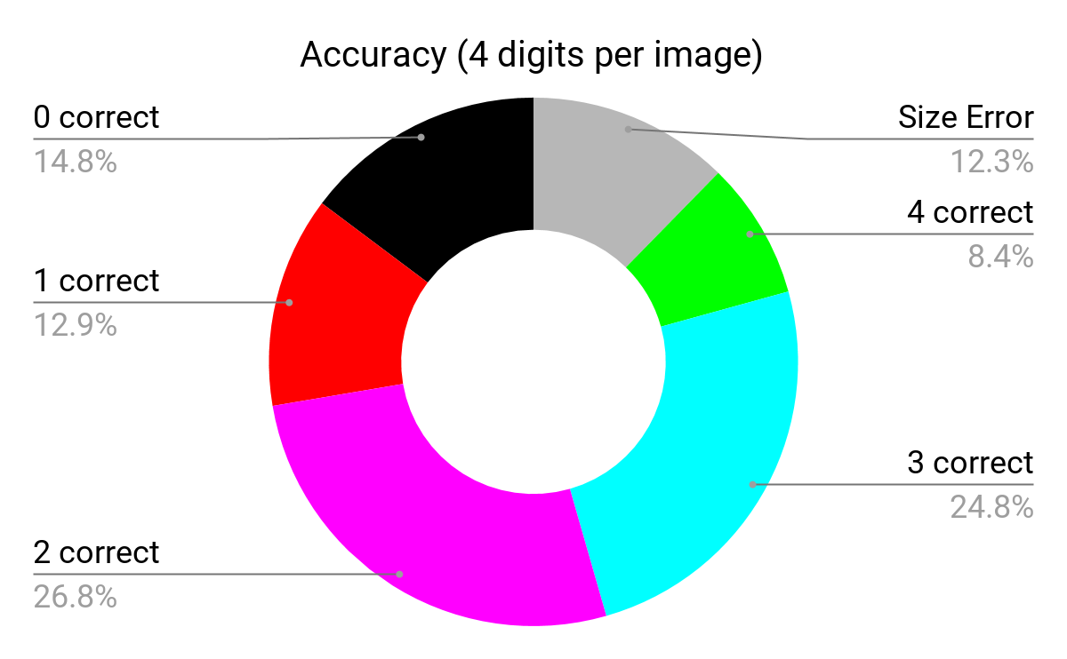
SVM Classifier
17,500 images Accuracy (on 15,042) Mean: 0.579 SD: 0.246

Slide 15
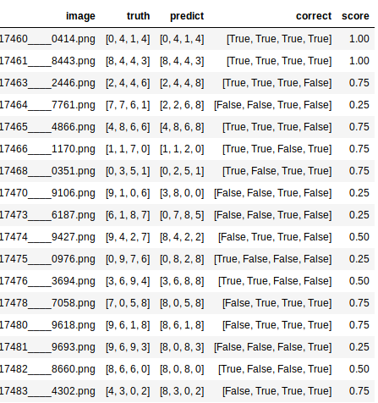
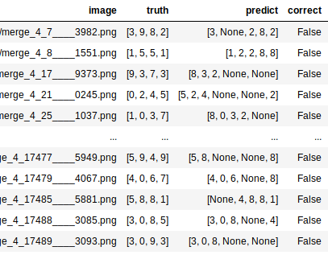
Results
Size Error results needs a deeper look.

Slide 16
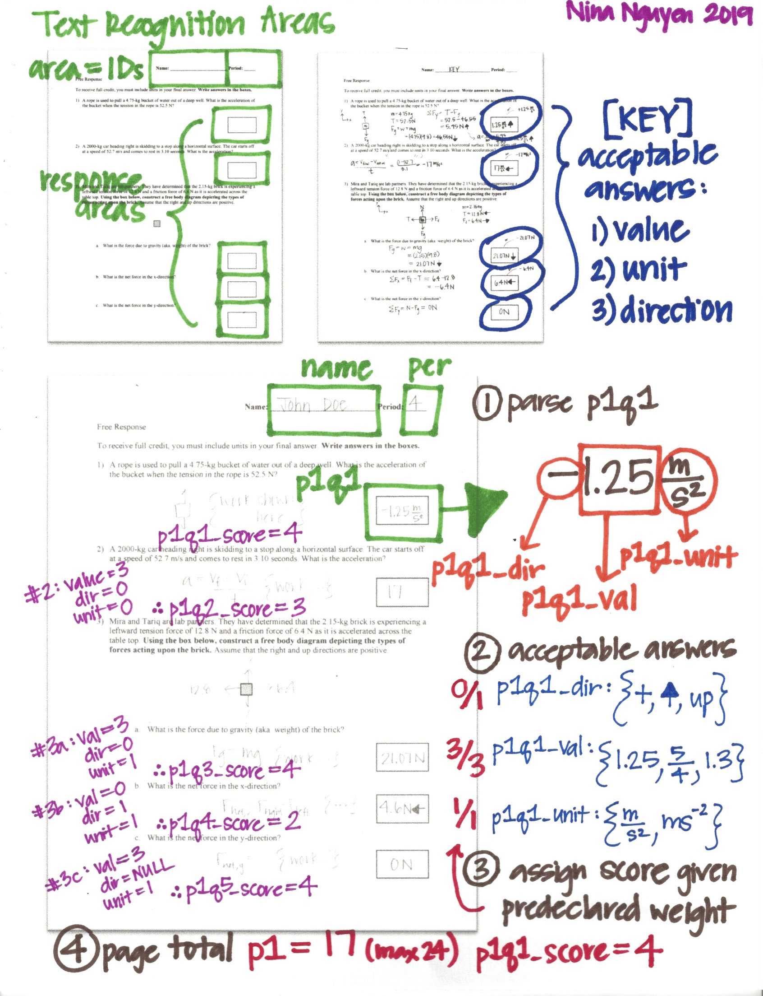
Nitty Gritty

Slide 17
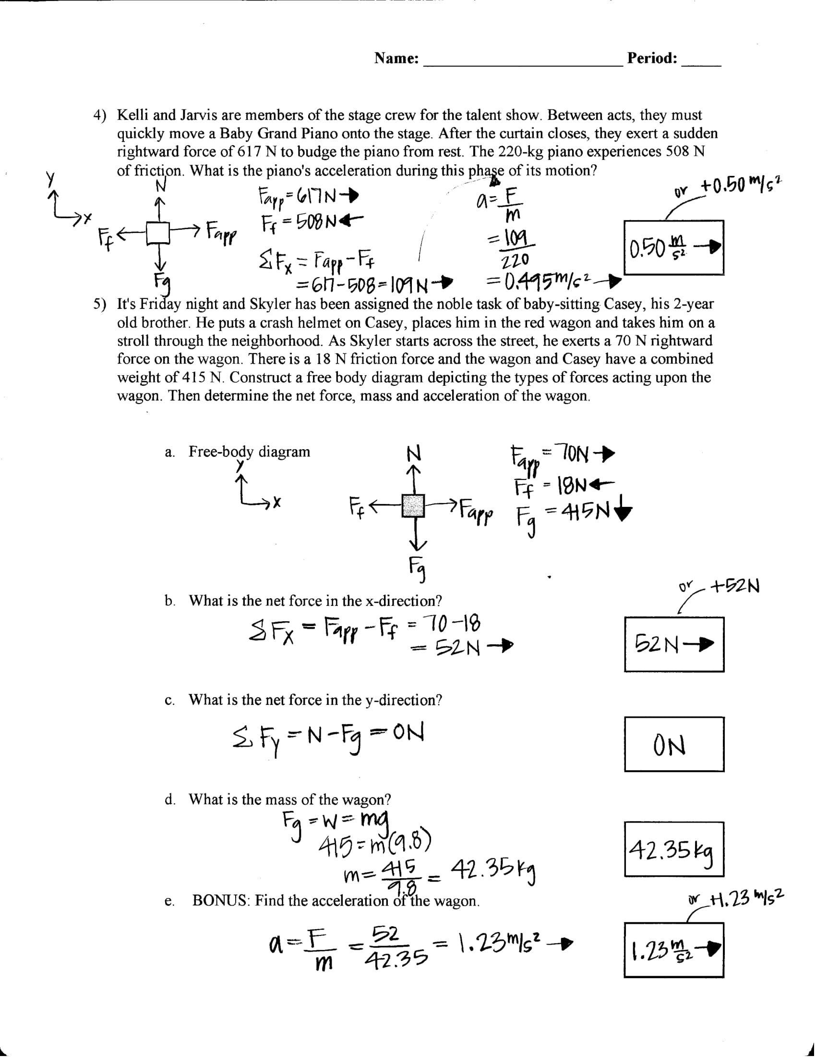
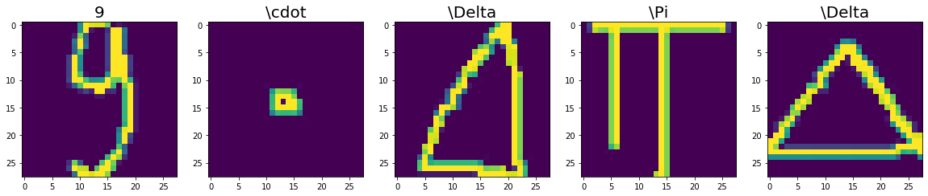
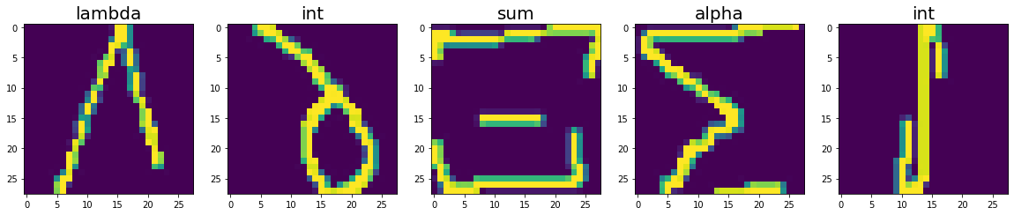
Questions?
Future Directions:
Organic chemistry OCR + NLP?!

